Slide 1
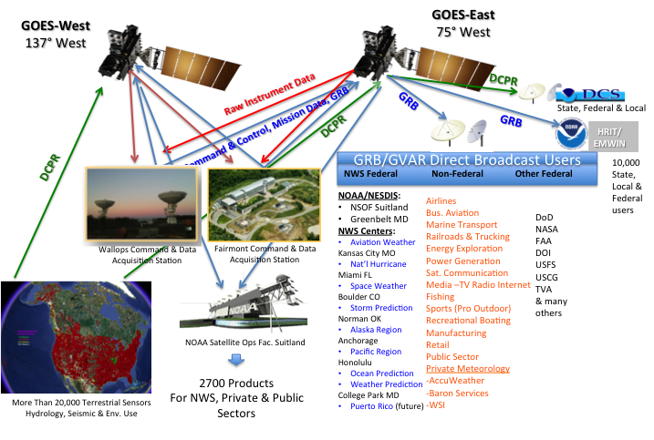
GOES-R Broadcast Architecture
Notes:
Graphic shows GOES-R with raw data into Wallops and Fairmont being calibrated, then immediately rebroadcast via both satellites to Federal and Non-Federal users.
Seven NWS sites use Direct Broadcast near-real time reception for either primary data reception method, or for data availability or data latency where other methods are inadequate.
Space Weather data which has a stressing latency requirement of 10 seconds from reception to end user warning delivery is in 1675-1695 MHz.
Also more than 30,000 hydrologic and environmental sensors are relayed via 1675-1680 MHz to Federal, State & Local sites for flood warning, hydroelectric dam control, tsunami warning, water reservoir, stream and river monitoring, seismic, tidal gages and environmental use. Over 90% of the source data for flood warnings in the US pass through this spectrum in near-real time.
Thousands of private sector users receive near real time NOAA weather data, intended primarily for Emergency Managers, at 1694.1 MHz. Some communities directly trigger audible warning sirens from the Emergency Managers Weather Information Network.
The three columns of data shown reflect some of the NOAA-Federal, other-Federal and non-Federal industry segments that receive data or (products generated from this data) in the 1675-1695 MHz to support their efforts.
This data is received continuously 24/7/365.

Slide 2
GOES Services: GRB, DCS, EMWIN, HRIT
GRB/GVAR: Primary Relay of full resolution, calibrated near-real-time data/images from each instrument on the spacecraft observatory. Federal & non-Federal use
DCS: Data Collection System real-time relay of about 25,000 remotely located hydrological or environmental sensors on predefined frequencies and schedules. 750,000 msg per day. Federal, state, local & private use
EMWIN: Near real time service providing weather forecasts, warnings, graphics from NWS into 1 meter L-band antenna for Federal, state, local & private users.
HRIT/LRIT: Broadcast of low-resolution GOES (& polar) imagery, DCS and other products to remotely located terminals for Federal, state, local and private use.
Notes:
Four distinct downlink services serve Federal or non-Federal users in 1675-1695 MHz
GOES-Rebroadcast or GOES Variable consists of all of the data from the spacecraft payloads on the new series or the current satellites respectively. This is time-referenced, calibrated, full resolution sensor data in meaningful sensor units. Some sensors have derived geophysical variables such as ocean wave height, soil moisture, ice concentration at the same full resolution. Space weather data from the near earth environment is contained within the GRB downlink.
Data Collection System is a near real time relay of remote hydrologic and environmental sensors with a complex downlink handling 750,000 messages per day for Federal, State and Local users. This data is available directly and also via LRIT/HRIT relay over GOES/GOES-R
Select users can not accommodate the full volume of GRB/GVAR, such as maritime users and rely upon LRIT/HRIT. (Low Rate or High Rate Information Transmission)
Emergency Managers Weather Information Network (EMWIN) is a very low cost, receiving system reliable during extreme wind and precipitation events under trying conditions. EMWIN is intended for Emergency Managers and Public Officials who require meteorological warnings, imagery and related data for decision making. One meter L-band antennas with battery power continue to function during hurricane winds and extreme weather events when the terrestrial power or internet infrastructure has failed.

Slide 3
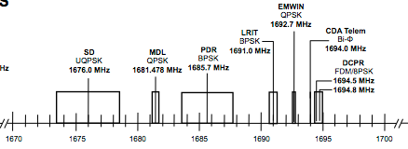
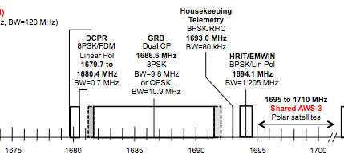
1675-1695 MHz Meteorological Use Current Use or Planned
GOES-
NOP
Broadband
AWS-3
GOES-RSTU
Broadband
AWS-3
Notes:
L-band downlink spectrum is shown on the current (GOES NOP) and future generations (GOES-R S T & U) of the nation’s geostationary weather satellites.
Major links are shown, with items in “blue” indicative of NOAA L-band broadcast downlinks in this band.
Also shown are the handset to tower services just sold in the AWS-3 auction and the tower-to-handset services in spectrum leased by LightSquared in 1670-1675 MHz

Slide 4
NOAA’s L-Band Environment
Legislative Recommendation for
Sharing by 2017
LightSquared leases
Under Evaluation for Sharing
Auctioned Jan 30 For Sharing
Today
POES/MetOp
2016 - 2030
MHZ
1670
1675
1680
1685
1690
1695
Radiosondes
1710
GOES-R Rebroadcast
Post-2030
DCPR
TLM HRIT
EMWIN
Commercial
1710 - 1755
Adjacent Bands
Radiosondes
POES & MetOp
Radiosondes

Slide 5
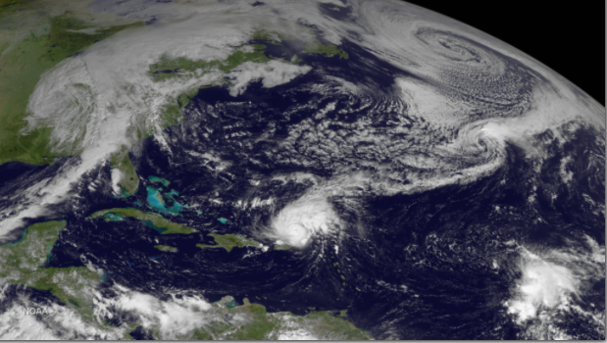
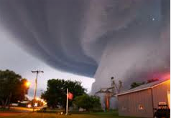
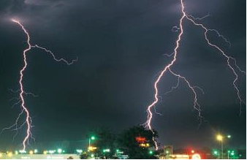
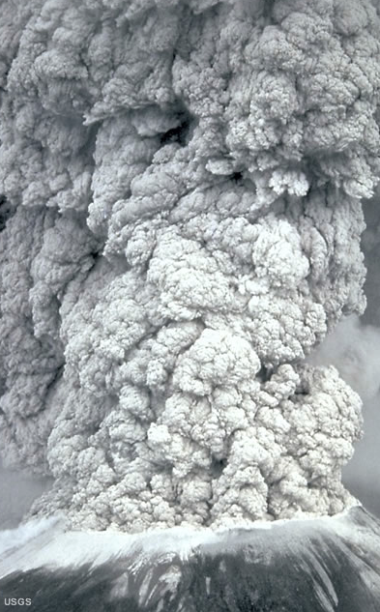
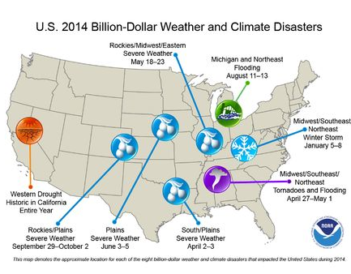
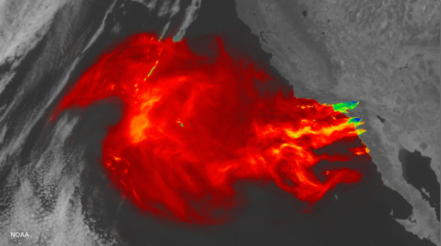
Economic Impact of Weather
Tornados
Hurricanes & Storm Surge
Lightning
Wildfires
Volcanic Ash
Snow
Notes:
Weather has a significant impact on the economy of the United States. The nation’s business community looks at weather impacts in terms of billions of dollars annually.
Freezing weather in one part of North America about one year ago, that first drove the broadcast media to use the term “polar vortex”, chipped roughly $3 billion off American output in one week’s time. Studies led by the National Center for Atmospheric Research finds routine weather events can add up to an annual economic impact of as much as $485 billion (2008 dollars) in the United States.
On top of that we have natural disasters, that are not included in the above numbers.
Natural disasters cause a lot of damage, that impacts property and lives. The U.S. has sustained 178 weather events since 1980 where overall damages/costs reached or exceeded $1 billion dollars (including CPI adjustment to 2014). Total cost of these 178 events exceeds $1 trillion. Another study estimates that hurricanes have pushed down the world’s annual GDP growth by 1.3 points in 1970-2008.
Key business segments that rely on timely and accurate weather – commercial and business aviation; roadway, rail & maritime transportation; operation of the power generation infrastructure; energy exploration and production; flood warning and drought prediction for agriculture and endangered populations; users of GPS; operators of man-made satellites; manned spaceflight; manufacturing and outdoor sporting events such as the NFL, MLB and recreational boating.
Some segments use Federal meteorological or hydrological products; others rely on specialized data provide by the private weather enterprise. Direct Broadcast is essential for these non-Federal applications.

Slide 6
Non-Federal User Categories
Private Sector Weather Enterprise
Companies developing value-added products for use by multiple sectors of the economy: Commercial & Business Aviation, Energy Production, Manufacturing, Land/Rail/Maritime Transportation, Broadcasting/Media, Agriculture others
State, Tribal, Local & Private Water Managers, hydrological applications for Data Collection System
Emergency Managers, Public Agencies including local jurisdictions requiring near-real time, high availability NWS data, forecasts, warnings, and products via the Emergency Managers Weather Information Network.
EMWIN is used to insure reliability triggering severe weather warning sirens in many parts of the country
In-house meteorological services
Select airlines, others
Non-Federal Space Weather end users (benefiting from Federal warnings issued by SWPC)

Slide 7
Additional discussions on this topic
AMS Panel January 7, 2015
A briefing held at the American Meteorological Society’s 95th Annual Meeting in Phoenix Arizona in January 2015
Link to the slides with audio may be found on the Internet:
https://ams.confex.com/ams/95Annual/webprogram/Session37898.html

