Slide 1
National Oceanic and Atmospheric Administration‘s (NOAA) National Weather Service (NWS)
NWS Use of Direct Broadcast Geostationary Weather Satellite Data
March 27, 2015
Mike Johnson, PhD
Satellite Team Lead, Office of Science and Technology
Notes:
*

Slide 2
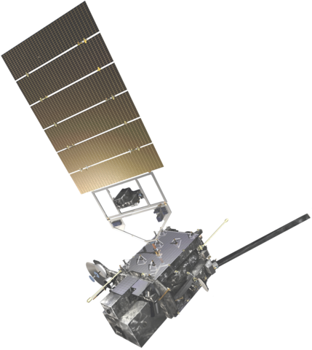
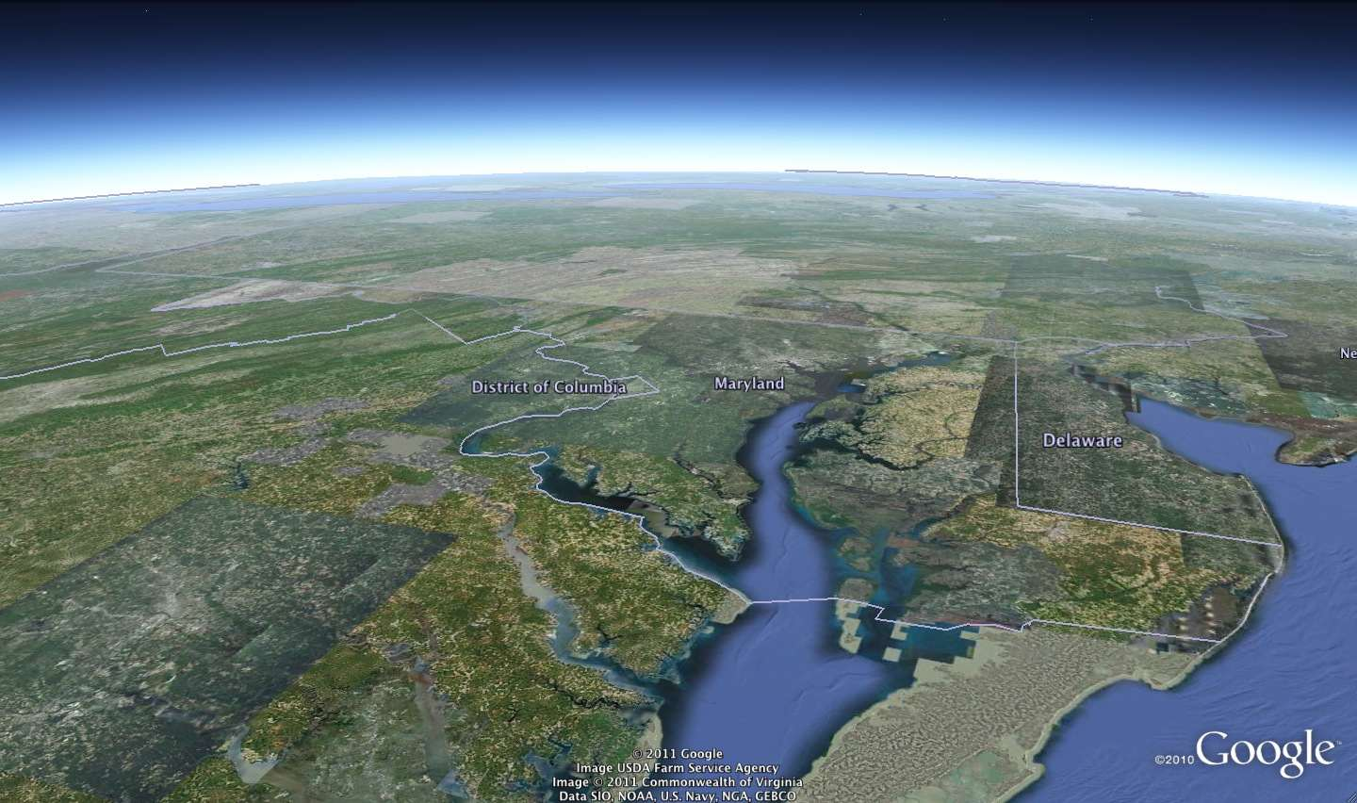
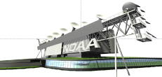
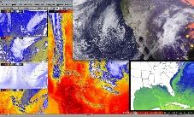
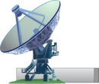
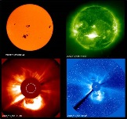
Key Product Generation Features
Continuous, real time product generation
Low latency
E.g. Cloud and Moisture Imagery (KPPs): CONUS and Full Disk – 50 seconds; Mesoscale – 23 seconds
High Reliability
Maintain a minimum Operational availability of 0.9999, averaged over a 30-day period
GOES-West
137° West
GOES-East
75° West
GRB downlink
GRB downlink
GRB Uplink
Command and Control, Mission Data, GRB
NOAA Satellite Operations Facility (NSOF) – Suitland, MD
Mode 4
L1b – 0.96 TB/Day
L2+ - 0.93 TB/day
(Compressed)
Wallops Command and Data Acquisition Station (WCDAS) – Wallops, VA
Only Primary Operational Concept is Shown

Slide 3
NWS GRB/H8 Antenna Systems Project
* NWS Sites Receiving GOES-R/Himawari Antennas. Some spare antennas not shown. All antennas are passive (receive only) antennas.
3

Slide 4
NWS GRB/H8 Antenna Systems Project
NWS Sites Receiving GRB/H8 Antennas
 | NWS Office | Location | Have GOES Antennas | Planned
 |  |  |  | GOES-R Antennas* | Himawari Antennas
1 | Alaska Region Headquarters | Anchorage, AK | X | W | X (TBD)
2 | Aviation Weather Center | Kansas City, MO | X | E, W, S
3 | National Hurricane Center | Miami, FL | X | E, W, S
4 | Pacific Region Headquarters | Honolulu, HI | X | W | X
5 | Space Weather Prediction Center | Boulder, CO | X | E, W, S
6 | Storm Prediction Center | Norman, OK | X | E, W, S
7 | NOAA Center for Weather and Climate Prediction | College Park, MD |  | E, W, S
8 | Weather Forecast Office, Guam | Barrigada, GU |  |  | X
* E – GOES-R East, W- GOES-R West, S- GOES-R Spare
4

Slide 5
NWS DB Site-by-Site Weather Support
(Missions - Slide 1)
Alaska Region (Anchorage, AK)
Aviation (Volcanic Ash Center, Aviation Weather Unit), Marine, Fire Weather, Public Forecast & Warning
Aviation Weather Center (Kansas City, MO)
Weather Guidance, Warning and Forecasts for Domestic and International Aviation
National Hurricane Center (Miami, FL)
Tropical Weather Guidance and Forecasts, Tropical Cyclone Watches and Warnings
Pacific Region (Honolulu, HI & Guam...H8 only in Guam)
Aviation, Marine, Tropical (Central Pacific Hurricane Center), Public Forecast & Warning

Slide 6
NWS DB Site-by-Site Weather Support
(Missions - Slide 2)
Space Weather Prediction Center (Boulder, CO)
Space Weather Monitoring, Warning and Forecasting
Additional Notes:
Unique for GOES-R use in that products will be produced on-site and sourced directly from DB antenna
SWPC looks at impacts caused by Solar Activity
Storm Prediction Center (Norman, OK)
Hazardous (Convective) Weather Guidance, Fire Weather Guidance

Slide 7
NWS DB Site-by-Site Weather Support
(Missions - Slide 3)
NOAA Center for Weather & Climate Prediction (College Park, MD)
Ocean Prediction Center – Open Ocean Marine Boundary Layer and Ocean Surface Guidance, Warning and Forecasts
Weather Prediction Center – National Guidance for Hydrometeorological Forecasts, and QPF, Winter Weather Desk, Alaska Desk
Climate Prediction Center – Climate Monitoring and Forecasts (week 2, monthly, seasonal, multi-seasonal)
Central Operations & Environmental Modeling Center – Numerical Weather & Climate Prediction, Automated Analysis and Prediction

Slide 8
Summary
NWS installing GOES-R/Himawari Direct Broadcast (DB) antenna's at 7 critical locations
This capability essential to high reliability at critical NWS sites.
NWS Weather Missions dependent on high availability of this data include all public weather service missions
Marine Weather
Aviation Weather
Fire Weather
Tropical Weather
Public Warnings & Forecasts
Space Weather

